Slide 1
Global Protest Analysis
Matthew Powell & John DiSessa

Slide 2
Dataset Introduction
Business Question: How can we understand past protests in order to predict the likelihood and severity of future protests?
2018 – 2022 (Kaggle dataset)
300+ protests
20+ variables per protest
Protest size, duration, motivation, country, significant outcome

Slide 3
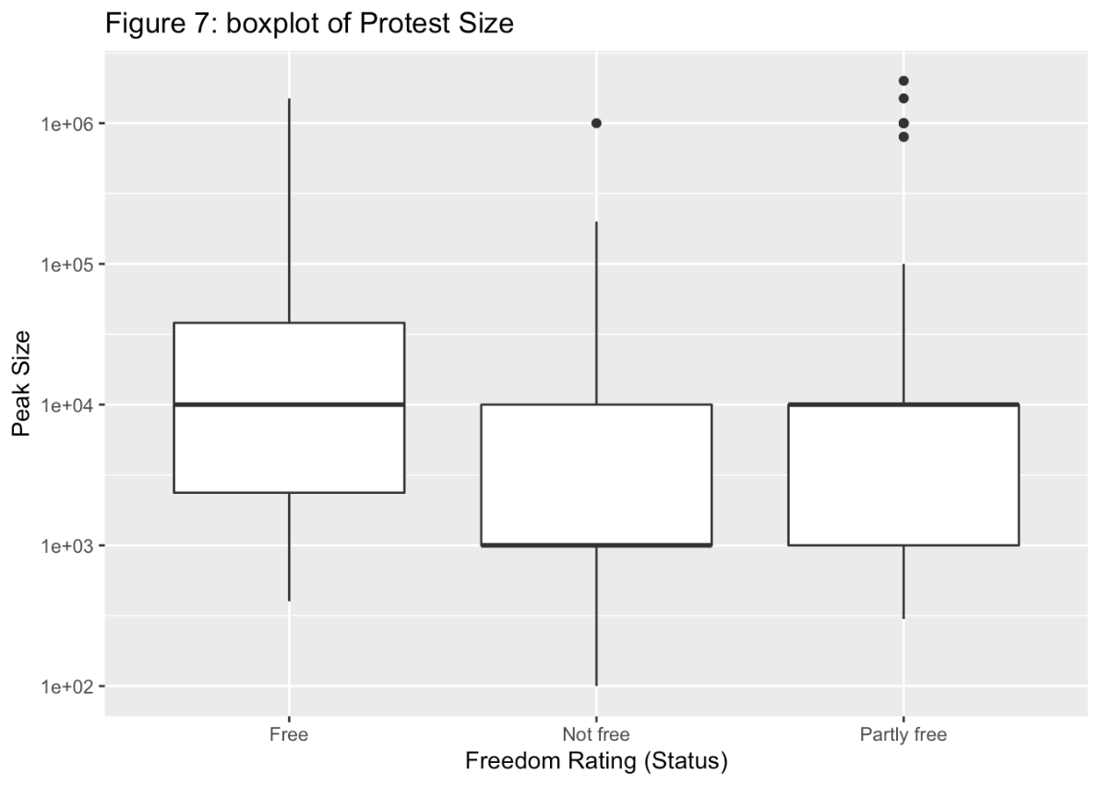
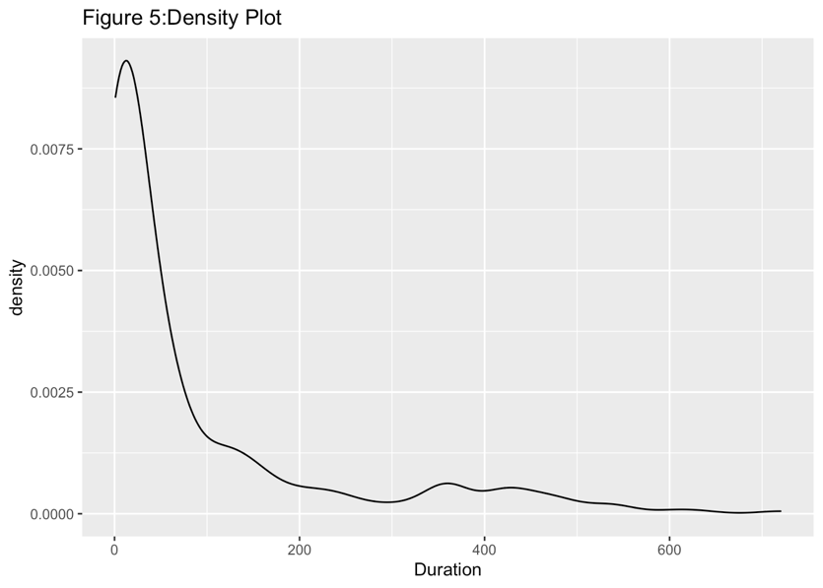
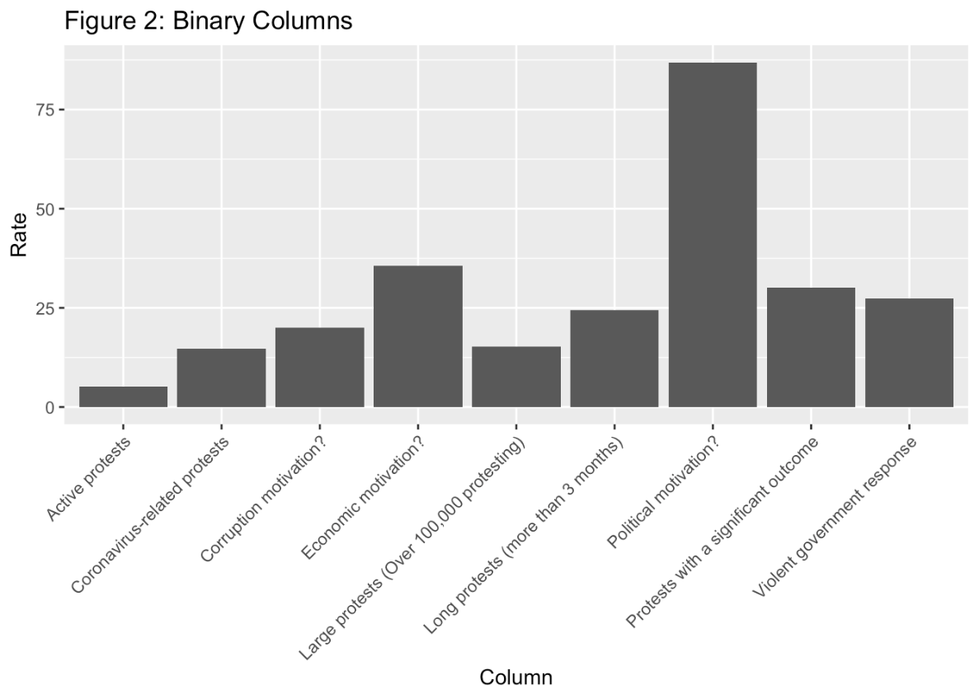
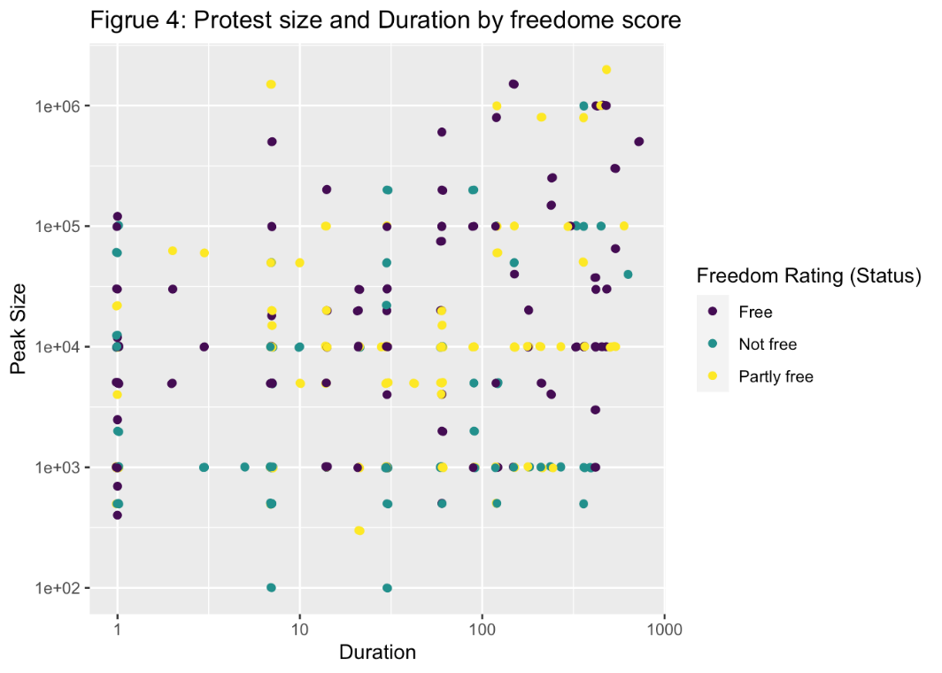
Exploratory Data Analysis
Data Cleaning
Protest Size & Duration converted to numeric
Logical form columns converted to binary (1,0)
Freedom rating & variables converted to factors in R
Political Motivation primary cause
Country’s freedom rating greatly affects protest frequency and size

Slide 4
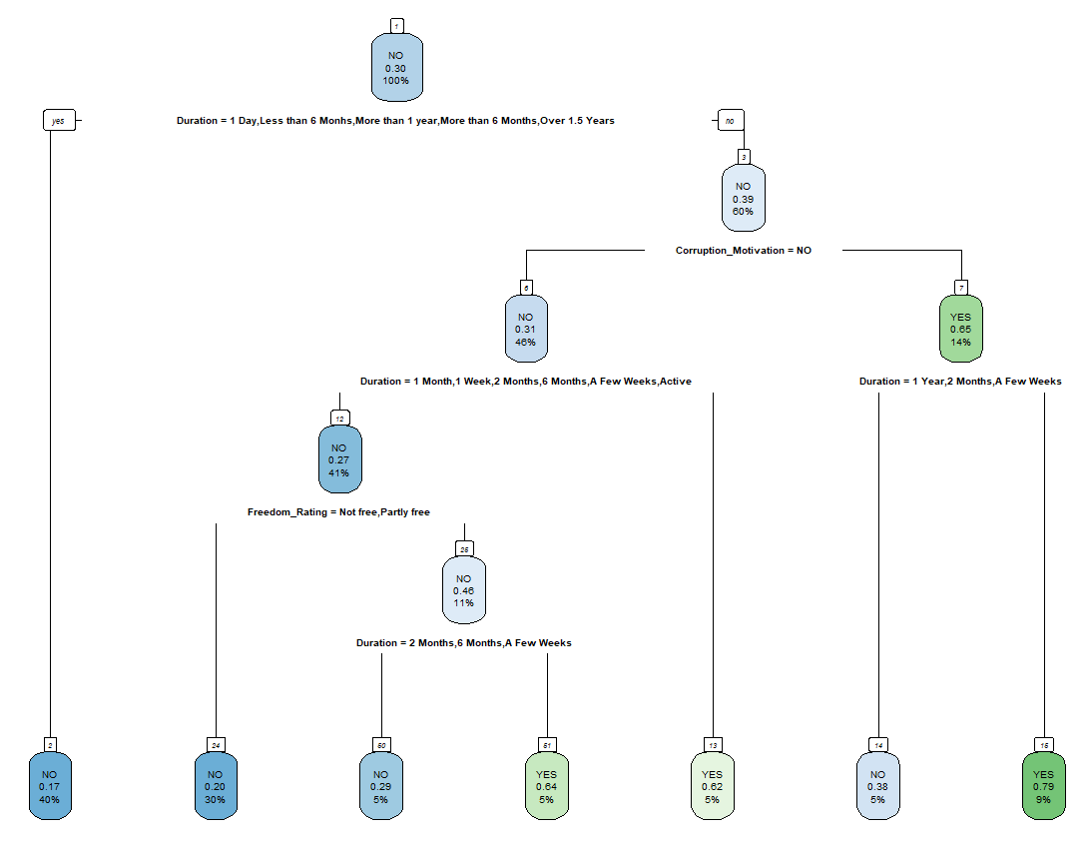
Decision Tree
80% training data, 20% testing data
Equal penalty matrix for Type I and Type II errors
Identifying if protest had significant outcome or not
Protest duration primary variable
Corruption motivation & country freedom rating significant

Slide 5
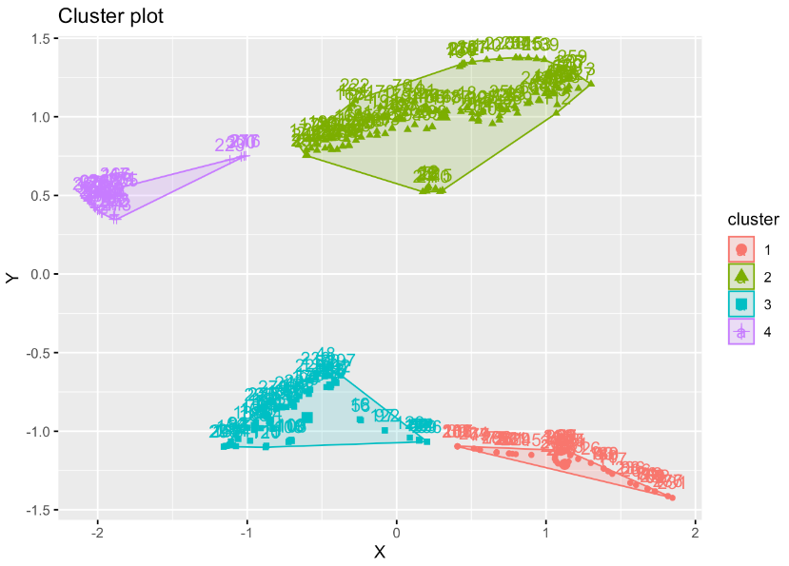
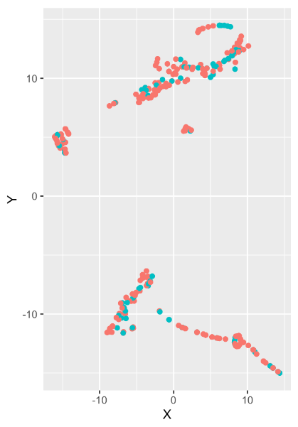
Clustering
Protests with significant outcomes differentiated
Group 3: 40% success rate & average duration of 9 days

Slide 6

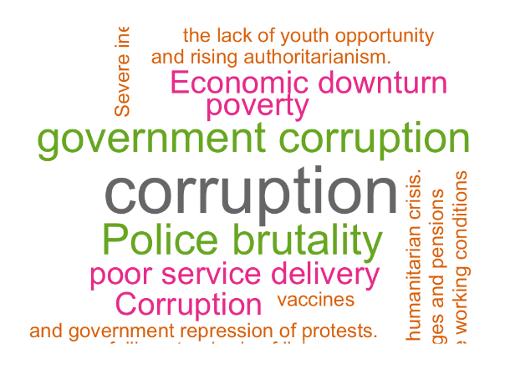
Natural Language Processing
General public almost always involved
Protests primarily occur due to politics or political corruption

Slide 7
Conclusion
Protest duration significant differentiator
Peak protest size small effect
Political motivation / government corruption
Protest significant outcome can be predicted with protest duration, protest motivation, and country freedom rating
Further analysis needs a larger and more accurate dataset

